Slide 1

RESTRAUNT WEBSITE
BY
PRANAV, HIMANSHU, ASHISH
(SECTION:- KOC14)
ROLL NO:-19, 24, 53
Department of Intelligence Systems
School of Computer Science Engineering
Lovely Professional University, Jalandhar
December-2022

Slide 2
STUDENT DECLARATION
This is to declare that this report has been written by us. No part of this report is copied from other sources. All sources from other source have been duly acknowledged. We are that if any part of the report is found to be copied. We are shall take full responsibility for it.
………………………………..
Pranav Abhiraj(12221955)
Roll no:- 19
………………………………..
Himanshu Singh Chauhan(12222272)
Roll no:- 24
………………………………..
Ashish Singh(1220357)
Roll no:- 53

Slide 3
1. Introduction
-------------------------------------------
2. Objectives Of The Project
-------------------------------------------
3. Features Of The Project
-------------------------------------------
4. Screenshots
-------------------------------------------
5. Future Scope Of Work
-------------------------------------------

Slide 4
INTRODUCTION
A restaurant is a business formation which prepares and serves food and drink to customers in return for money, either paid before the meal, after the meal, or with a running tab. Meals are generally served and eaten on premises.
Restaurants are more important than ever. At the tail end of 2014 the influential restaurant blog, Eater, published a round-up of the 60+ restaurants that opened in Boston just this past fall. The writer covered everything from Five Guys, a rapidly expanding quick service burger joint, to Cafe Artscience, a hybrid restaurant/lab/gallery space in Cambridge.

Slide 5
OBJECTIVES OF PROJECT
We can promote our portfolio online.
We can collect customer information.
We can effectively advertise on social media.
We can highlight customer feedback.
Contact Info
Photos

Slide 6
Features Of The Project
SIMPLICITY
CLEAR NAVIGATION
AN EFFICTIVE CONTACT PAGES
USING ANALYTICS
FOCUSING ON QUALITY OVER QUANTITY
SOCIAL NETWORKING

Slide 7
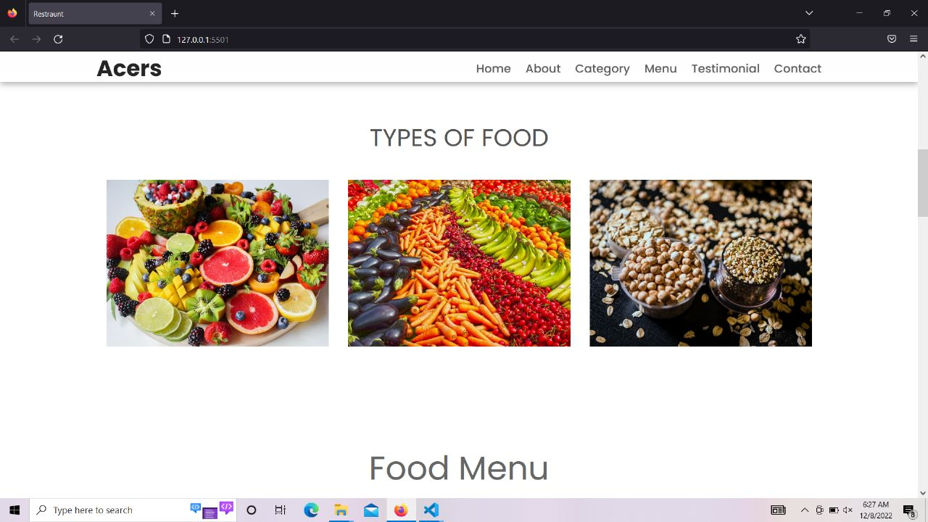
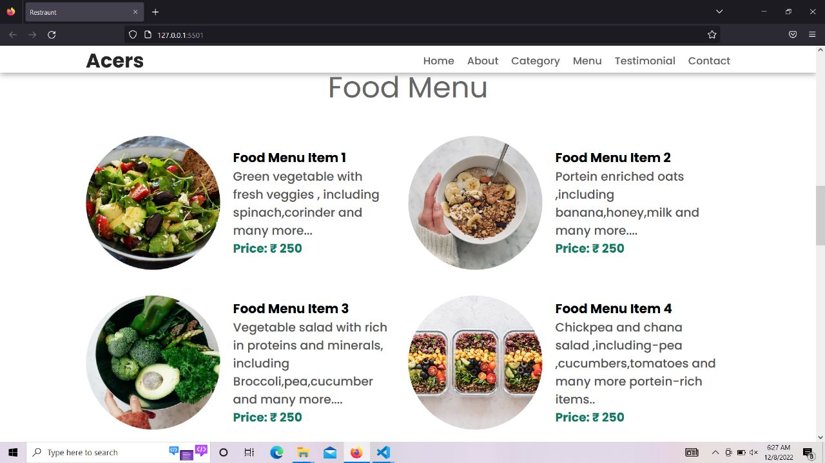

Slide 8
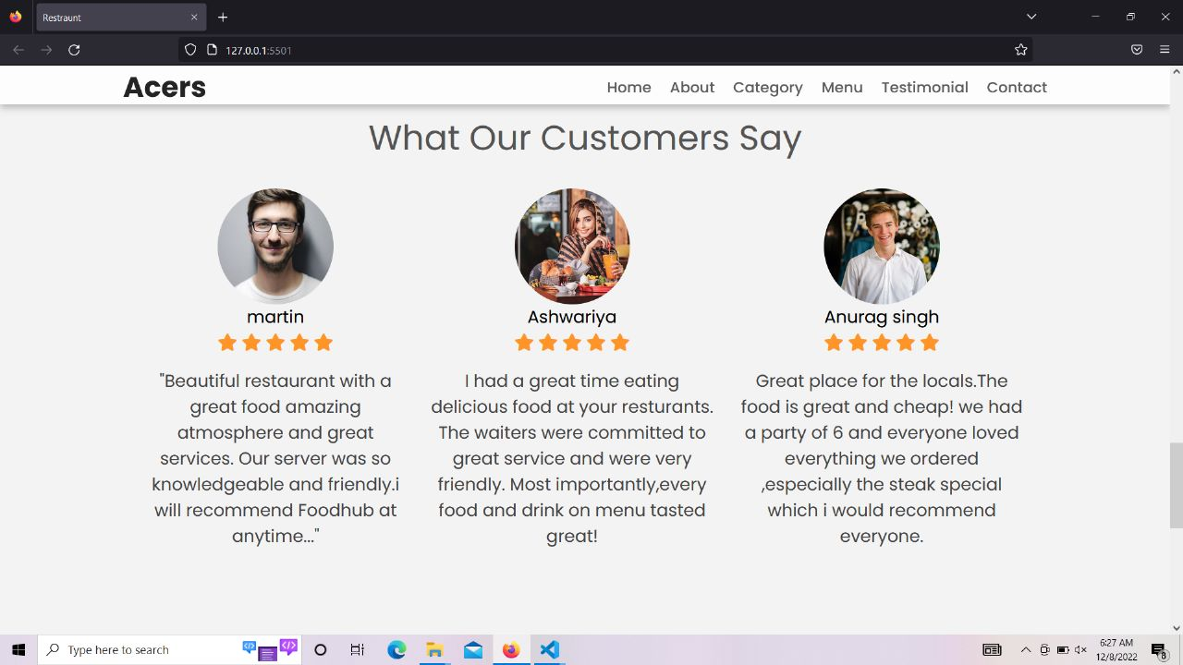
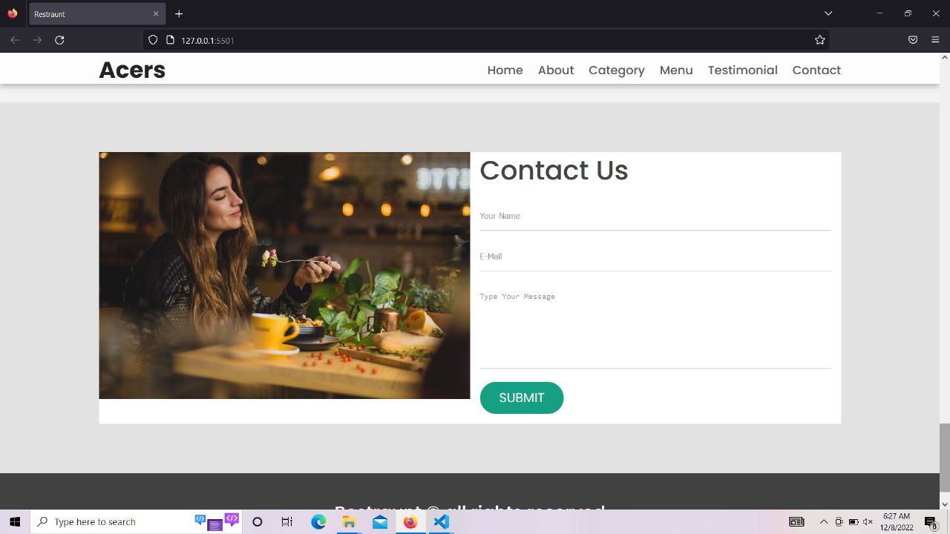

Slide 9
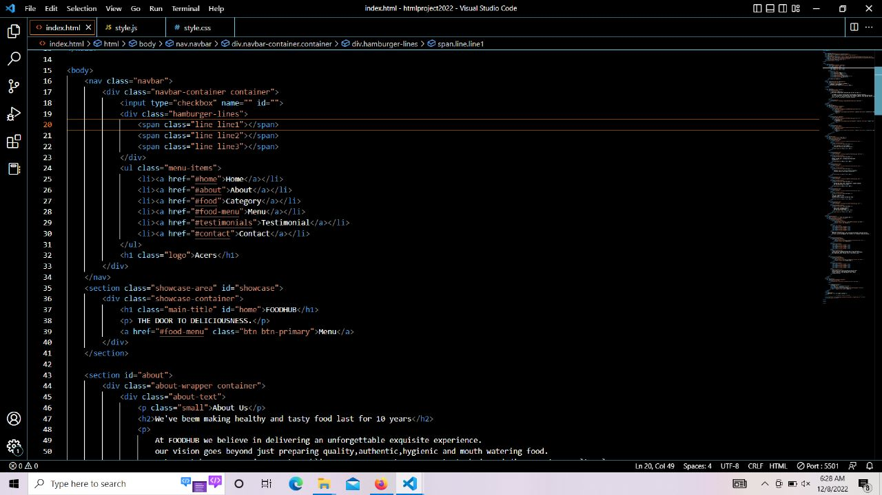
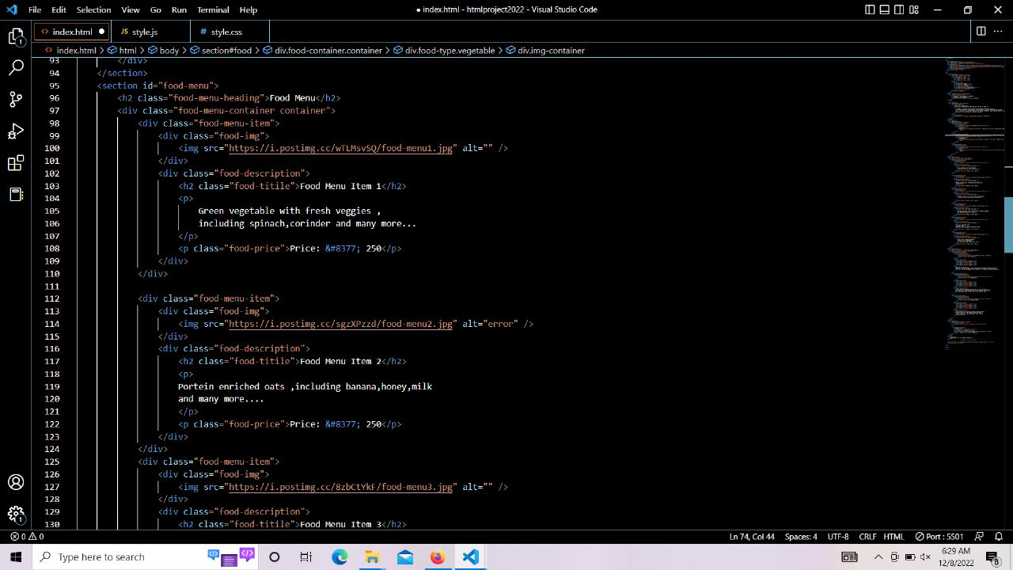

Slide 10
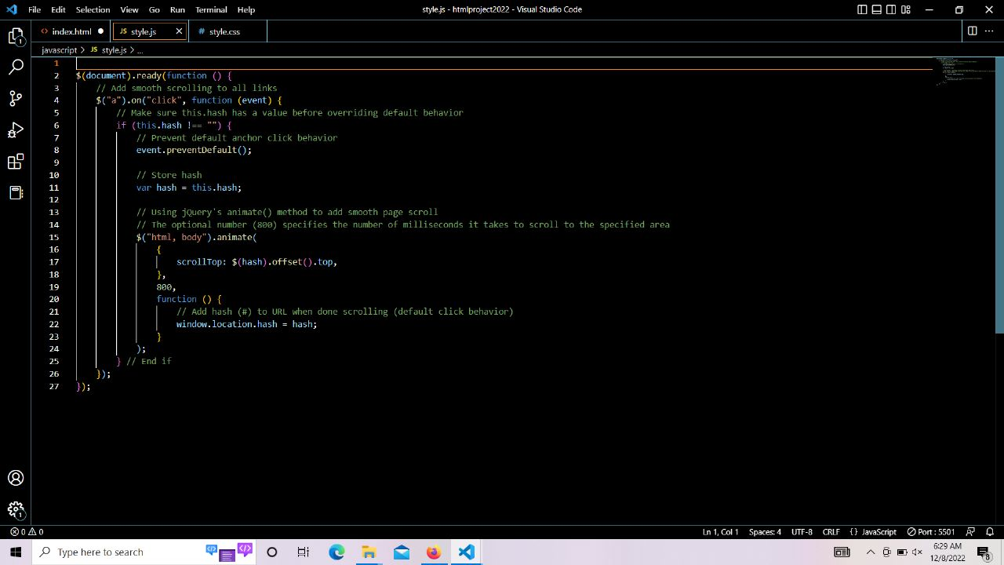
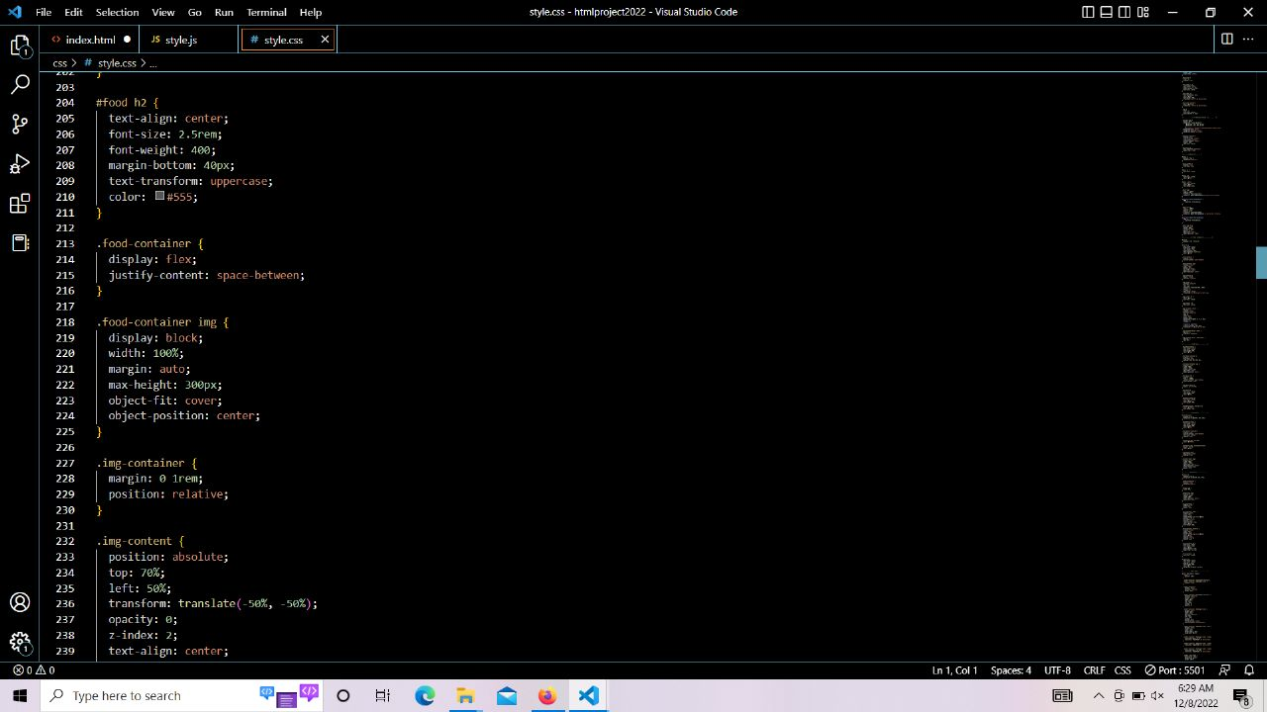

Slide 11
BONAFIDE CERTIFICATE
Certified that this project report “FOODHUB (RESTRAUNT WEBSITE)” is the bonafide work of “PRANAV ABHIRAJ, HIMANSHU SINGH CHAUHAN, ASHISH SINGH” who carried out the project work under my supervision.
Sushil Lekhi
CSE

